Slide 1
Basic Concepts (Part I)

Slide 2
프로그램
컴퓨터 프로그램
컴퓨터에서 실행될 때 특정 작업(specific task)을 수행하는 일련의 명령어들의 모음(집합체) (위키백과)
데이터를 표현하고 처리하는 것
데이터 표현 → 자료구조
데이터 처리 → 알고리즘
자료구조
컴퓨터 과학에서 효율적인 접근 및 수정을 가능케 하는 자료의 조직, 관리, 저장을 의미한다. 더 정확히 말해, 자료 구조는 데이터 값의 모임, 또 데이터 간의 관계, 그리고 데이터에 적용할 수 있는 함수나 연산을 의미한다. (위키백과)
알고리즘
어떠한 문제를 해결하기 위해 정해진 일련의 절차나 방법을 공식화한 형태로 표현한 것 (위키백과)

Slide 3
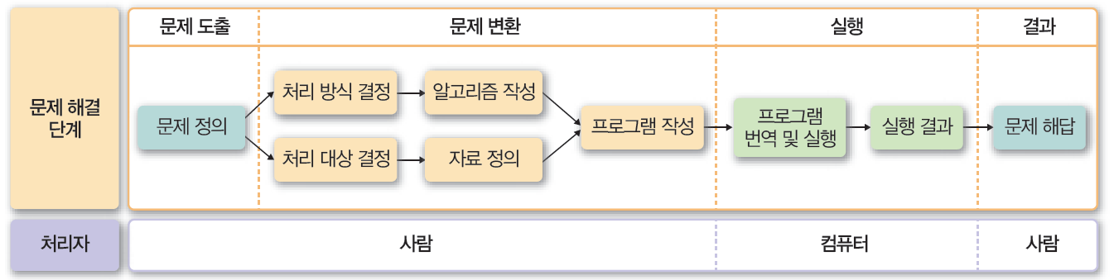
프로그램
문제 해결(problem solving) 과정
(C로 배우는 쉬운 자료구조)

Slide 4
알고리즘 표현 방법
알고리즘의 표현 방법
자연어(natural language)
인간의 언어로 표현
일관성이나 명확성을 유지하기 어려움
순서도(Flow chart)
복잡한 알고리즘을 표현하는 데 한계
프로그래밍 언어(programming language)
특정 프로그래밍 언어로 작성되어 다른 언어로 변환시 비효율적
가상(의사)코드(Pseudo-code)
프로그래밍 언어의 형태를 갖춘 가상 코드를 사용
특정 프로그래밍 언어로 구체화하기 쉬움

Slide 5
Pseudocode
Pseudocode
is an English-like representation of the algorithm logic
It is part English, part structured code
English part
무엇이 되어야 하는지(what must be done)에 관한 완화된 구문(relaxed syntax)을 제공
Code part
consists of an extended version of the basic algorithmic constructs: sequence, selection, and iteration

Slide 6
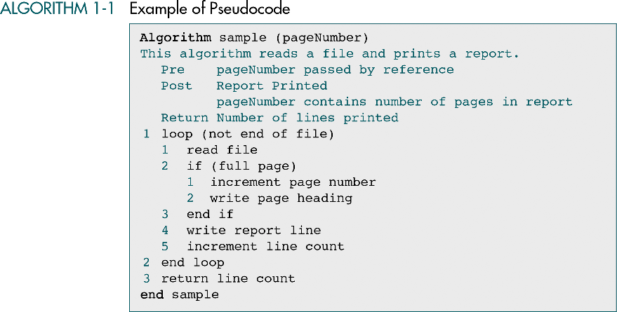
name
parameter
Algorithm header
purpose
precondition
postcondition
Return condition
Statement number
Ex) 1, 1.1, 1.2.2

Slide 7
Pseudocode
We use pseudocode to represent both data structures and code
Variables
데이터를 미리 선언할 필요는 없음
처음 사용할 때 자동으로 선언하는 것으로 간주
타입도 문맥에 따라 결정됨
Ex) Set count to 0 // 수치 데이터 count에 0을 할당
Data의 Structure는 선언되어야 함
node data link end node

Slide 8
Pseudocode
Statement constructs
Sequence
One or more statements that do not alter the execution path within an algorithm
Selection
Evaluates a condition and executes zero or more alternatives
1 if (condition) 1 action1 2 else 1 action2 3 end if
Loop
Iterates a block of code
Any algorithm could be written using only three programming constructs (by Dijkstra)

Slide 9
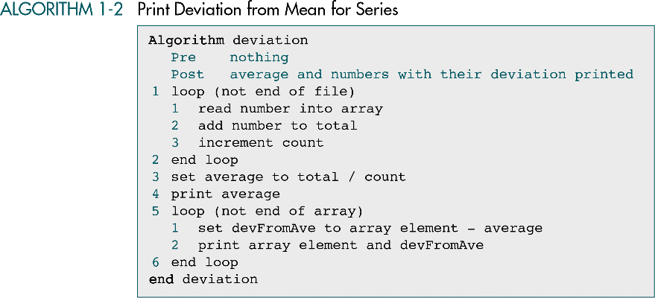
loop
variable

Slide 10
Atomic and Composite data
Atomic data
Data that consist of a single piece of information
Cannot be divided into other meaningful pieces of data
Ex) integer 4562
A.k.a) scalar data
Composite data
Data that can be broken out into subfields that have meaning
Ex) telephone number 02-3290-1114

Slide 11
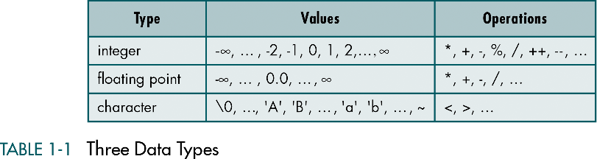
Data Type
Data type consists of two parts
A set of data
The operations that can be performed on the data

Slide 12
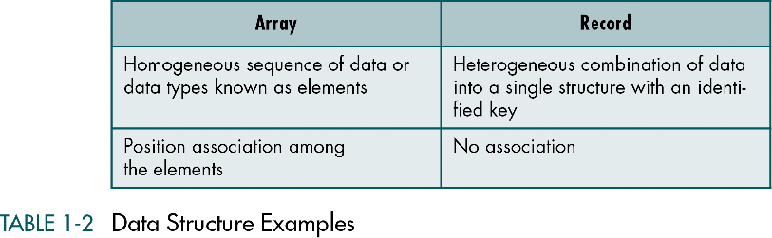
Data Structure
Data structure
Aggregation of atomic and composite data into a set with defined relationships
‘Structure’ means a set of rules that hold the data together.

Slide 13
Data Structures: Properties
Most of the programming languages support several data structures
In addition, modern programming languages allow programmers to create new data structures for an application
Data structures can be nested
A data structure may contain other data structures (array of arrays, array of records, record of records, record of arrays, etc.)

Slide 14
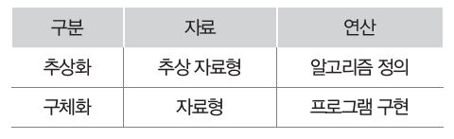
Abstract Data Type
데이터와 연산자의 특성을 논리적으로 추상화하여 정의한 자료형
추상화 – “무엇(what)인가?”를 논리적으로 정의
구체화 – “어떻게(how) 할 것인가?”를 실제적으로 표현

Slide 15
Abstract Data Type
ADT users are NOT concerned with how the task is done but rather what it can do.
An abstract data type is a data declaration packaged together with the operations that are meaningful for the data type.
We encapsulate the data and the operations on the data, and then hide them from the user.
All references to and manipulation of the data in a data structure are handled through defined interfaces to the structure.

Slide 16
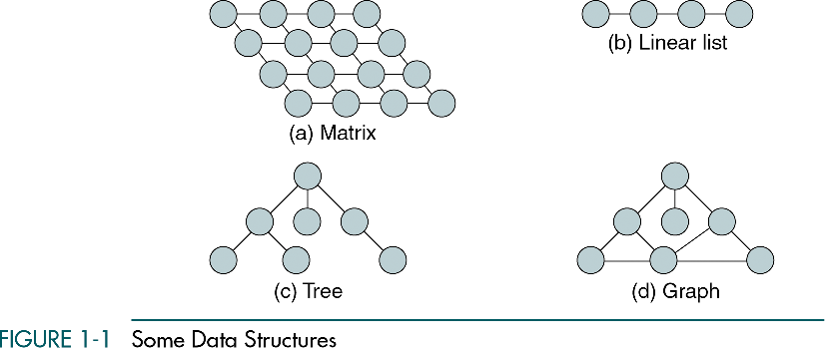
Data Structure

Slide 17
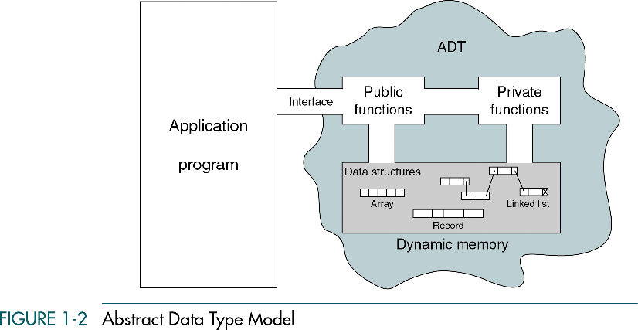
ADT model
Data는 오직 외부 인터페이스를 통해서만 다룰 수 있음
Only the public functions are accessible through this interface.

Slide 18
Typical ADTs:
Lists
Stacks
Queues
Trees
Binary search tree, AVL tree, B-tree
Heaps
Graphs

Slide 19
ADT Implementations
There are two basic structures we can use to implement an ADT list: arrays and linked lists

Slide 20
Array Implementations
In an array, the sequentiality of a list is maintained by the order structure of elements in the array (indexes).
Although searching an array for an individual element can be very efficient,
Insertion and deletion of elements are complex and inefficient processes
For this reason arrays are seldom used, especially when the list changes frequently

Slide 21
Linked List Implementations
A Linked List is an ordered collection of data in which each element contains the location of the next element or elements
In a linked list, each element contains two parts: data and one or more links.
The data part holds the application data – the data to be processed.
Links are used to chain the data together. They contain pointers that identify the next element or elements in the list.
In linear linked lists, each element has only zero or one successor.
In non-linear linked lists, each element can have zero, one or more successors.

Slide 22
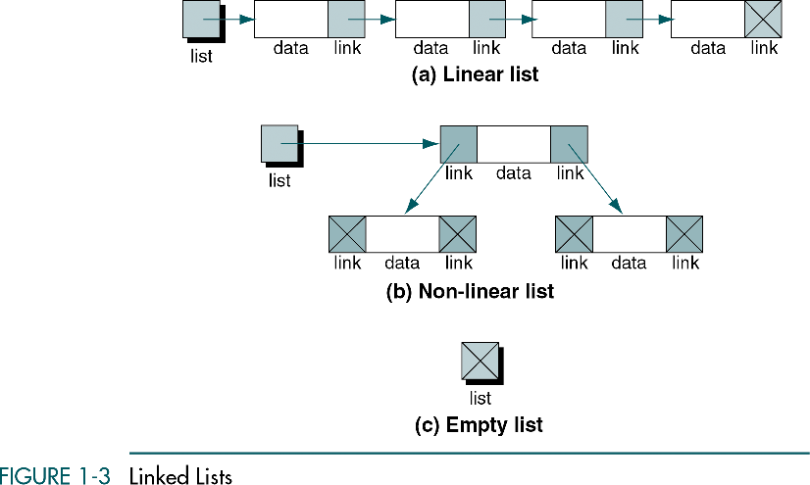

Slide 23
Linked Lists vs. Arrays
The major advantage of the linked list over the array is that data are easily inserted and deleted.
It is not necessary to shift elements of a linked list to make room for a new elements or to delete an element.
However, because the elements are no longer physically sequenced in a linked list, we are limited to sequential searches.

Slide 24
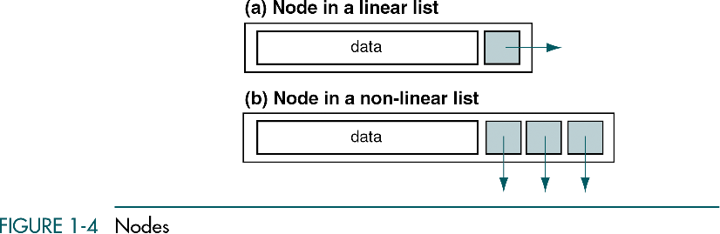
Nodes
A node is a structure that has two parts: the data and one or more links.
The nodes in a linked list are called self-referential structures. In such a structure, each instance of the structure contains one or more pointers to other instances of the same structural type.

Slide 25
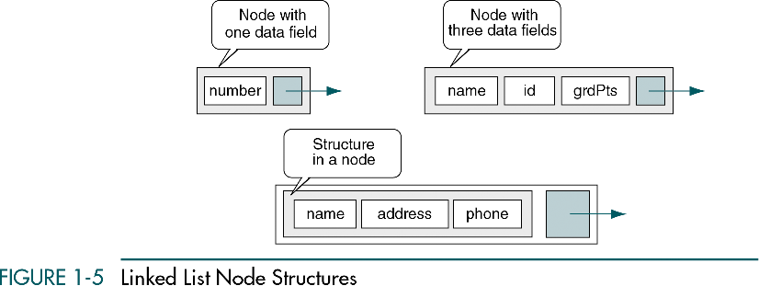
Nodes
The data part in a node can be a single field, multiple fields, or a structure that contains several fields, but it always acts as a single field.

